Slide 1
Rotary Days
Planned September 2014

Slide 2
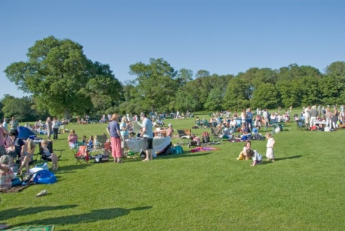
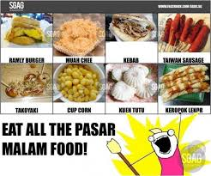
Rotary Days can take any form, as long as they are fun and appealing to the non-Rotary public. Here are just a few possibilities: • Hold an outdoor picnic or barbecue • Host a sporting event or concert • Organize a family fun run • Align the event with a public parade or festival • Sponsor an event at a museum, art gallery, or cultural center • Secure an auditorium or arena and plan a ticketed reception or buffet dinner

Slide 3
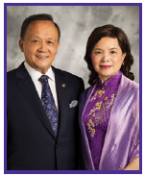
Tips for Rotary Day planners • Highlight the work of ordinary Rotary members doing extraordinary humanitarian work. • Consider including a hands-on service project as part of the event to give visitors the chance to see firsthand how Rotary benefits the community. • Recognize non-Rotary community members who embody Rotary’s service ideals. • Seek coverage for the event in local news media.
This year, I am urging all Rotarians to Light Up Rotary by participating in Rotary Days.
Gary C.K. Huang President, Rotary International, 2014-15

Slide 4
Onze Ideeën: • Een evenement houden op Nieuw Amsterdam in September 2014 die we samen doen tijdens de Pasar Malam die gehouden wordt eind september, of een week daarvoor maar dan alleen met de Rotary. • De Rotary Day gezamenlijk doen met Rotary 3CSu, Rotaract, Interact, Innerwheel. • Een expo houden van projecten die wij reeds hebben gedaan en informatie bieden waarvoor men de Rotary kan benaderen.

Slide 5
Wat zijn jullie ideeën?
Please give us your feedback…..
Rotary Days

